Slide 1
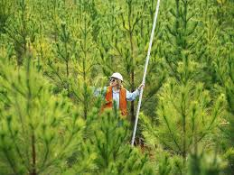
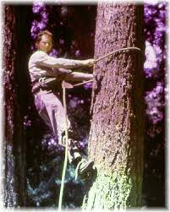
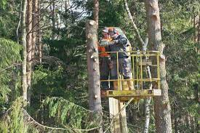
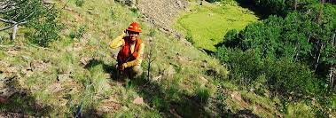
This week’s career of the week is…..
Forestry Worker

Slide 2
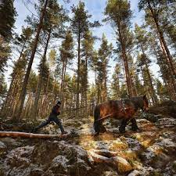
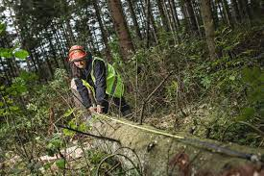
What is it??
Forestry workers manage trees, plants and the environment in forests and woodland. They can also be called a forest craftsperson or lumberjack.

Slide 3
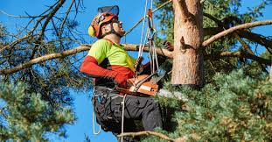
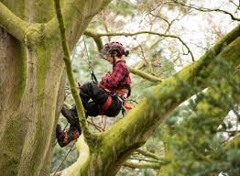
Related Careers
Tree surgeons, also called tree climber or arborist carry out tree work including planting, cutting down, maintenance and hazard assessments.
Arboricultural officers, also called a tree officer or forest officer, manage and maintain trees for local councils and arboricultural contractors.

Slide 4
Where could I work?
As a forestry worker, you could work in a park or in woodland. Your working environment may be outdoors in all weathers.
As a tree surgeon, you could work in parks and gardens, on the streets, in woodland or on rail tracks. Your working environment may be outdoors in all weathers and at height.
As an aboricultural officer you could work in woodland, in an office, in parks and gardens or on the streets. Your working environment may be at height and outdoors in all weathers.

Slide 5
How Much Could I Earn?
Average salary for a forestry worker is £15,000-
£27, 000 per year.
Tree surgeons can earn £20,000- £38,000 per year.
Aboricultural officers earn between £20,000 and £40,000 per year.

Slide 6
What qualifications would I need?
You could study for a foundation degree, higher national diploma or degree in a subject like:
forestry
arboriculture
countryside management
forest management
woodland ecology and conservation
To get onto a course like this you would usually need:
1 or 2 A levels, or equivalent, for a foundation degree or higher national diploma
2 to 3 A levels, or equivalent, for a degree

Slide 7
Or you could study at college
You could take a college course to learn some of the skills needed in this job. Sparsholt offers such courses. Courses include:
Level 2 Certificate in Land-based Technology
Level 3 Diploma in Forestry and Arboriculture
T Level in Agriculture, Land Management and Production
Entry requirements
You'll usually need:
2 or more GCSEs at grades 9 to 3 for a level 2 course
4 or 5 GCSEs at grades 9 to 4 for a level 3 course
4 or 5 GCSEs at grades 9 to 4 including English and Maths for a T level

Slide 8
Or you could do an apprenticeship and earn while you learn
The following apprenticeships can help you get into this role:
Level 2 Arborist
Level 2 Forest operative
Entry requirements
You'll usually need:
some GCSEs, usually including English and maths, or equivalent, for an intermediate apprenticeship

Slide 9
Or
Volunteering for a woodland or wildlife charity is a good way to get experience, which could help you when looking for work. You can find opportunities with the following organisations:
Woodland Trust
The Conservation Volunteers
Forestry England
Other Routes
You can apply for a graduate training scheme with Forestry England.

Slide 10
Other skills needed
The ability to use your initiative
To be thorough and pay attention to detail
Leadership skills
Knowledge of geography
The ability to work well with others
Patience and the ability to remain calm in stressful situations
Knowledge of maths
Excellent verbal communication skills
To be able to carry out basic tasks on a computer or hand-held device
You'll need to:
be able to cope with working at height
have a Certificate of Competence, if you carry out hazardous tasks using a chainsaw

Slide 11
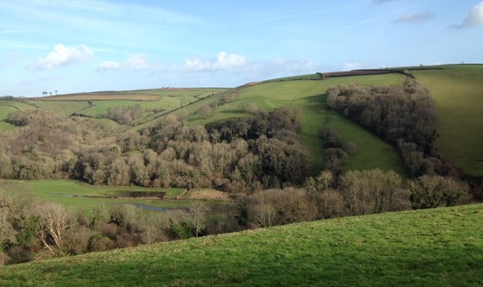
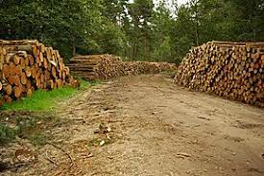
So what do forestry workers do?
https://www.youtube.com/watch?v=73050YM4CnY&t=19s

