Slide 1
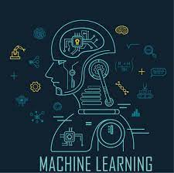
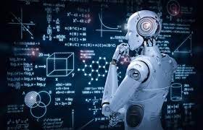
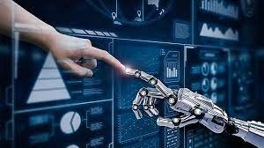
This week’s career of the week is…..
Machine Learning

Slide 2
What is it??
Machine learning is a specialist aspect of AI (artificial intelligence) concerned with training computers to learn from inputted data without the requirement for further programming for every situation. It involves creating the algorithms (sets of rules) and computer programmes that enable machines to learn in a similar way to humans.

Slide 3
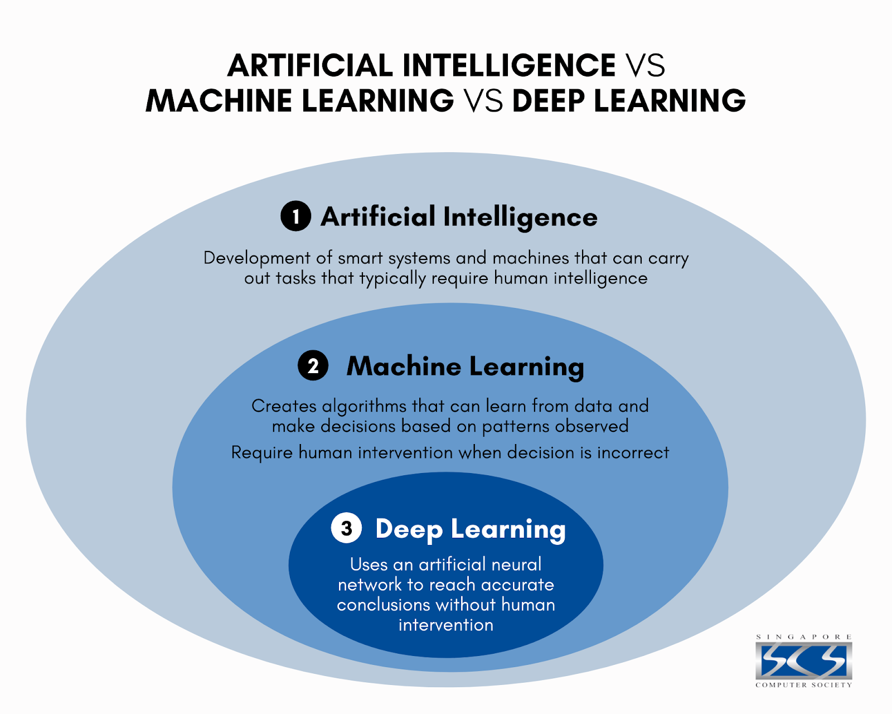

Slide 4
What types of industies involve AI?
To give you an idea about the scope of AI, here are a few examples of areas in which it is having an impact:
Writing and other creative work – generative AI tools, like ChatGPT are large language models (LLMs) that use deep learning algorithms to identify patterns and connections; they are trained with so much data that they can create new text, images or music in response to specific criteria
Medicine – AI can, for instance, help diagnosis disease, speed up drug discovery and monitor the spread of infections
Customer services – think of those chatbots that answer your questions via online chat or over the phone
Marketing – for example, when you do your online shopping other products you may like are suggested
Manufacturing – AI is used to automate production, predict when machines need maintenance and detect quality issues
Security – face-recognition technology, for example, has applications ranging from assisting with police investigations to adding security features to technology
Farming – AI can help monitor crops, soil and weather conditions, and identify the best time for harvesting

Slide 5
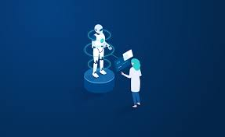
Where could I work?
Specialists in machine learning can work for employers in industries as diverse as pharmaceuticals, logistics, finance and engineering – in fact any public or private sector organisation where AI has (or has the potential to have) an impact. They also work for firms that specialise in undertaking AI projects for clients; many are small, start-up enterprises.
Those with expertise in machine learning also work in consultancy, for research institutes or in government departments and agencies, such as the UK Office for Artificial Intelligence.

Slide 6
How Much Could I Earn?
Machine learning is a specialised so well paid job- minimum salaries start at around £37, 500 per year, but the average salary for this role is £67, 400.

Slide 7
What qualifications would I need?
There’s no one route into machine learning, but employers seek people who are enthusiastic and knowledgeable about AI. Most people who work in machine learning are graduates, although it might be possible for non-graduates who have developed their coding and other technical skills to a very high level to find employment.
You could either take a degree in AI or a related subject or keep your options open by studying another degree subject such as data science, computer science, maths, statistics, physics and electronic engineering.
Entry to degree level usually requires ‘A’-levels or Level 3 BTechs, or T-Levels.

Slide 8
What skills do you need?
To work in machine learning you need very strong analytical and creative problem-solving skills. You definitely need to like maths! The exact technical skills required vary depending on the position, but you need coding ability, knowledge of relevant programming languages (eg Python and Java) and confidence with various software tools.
You must be able to concentrate and pay attention to detail. It’s also important to work well in a team and to be able to communicate clearly – you often have to explain complex information to clients and other stakeholders who are not experts. Some roles call for project and/or people management skills.

Slide 9
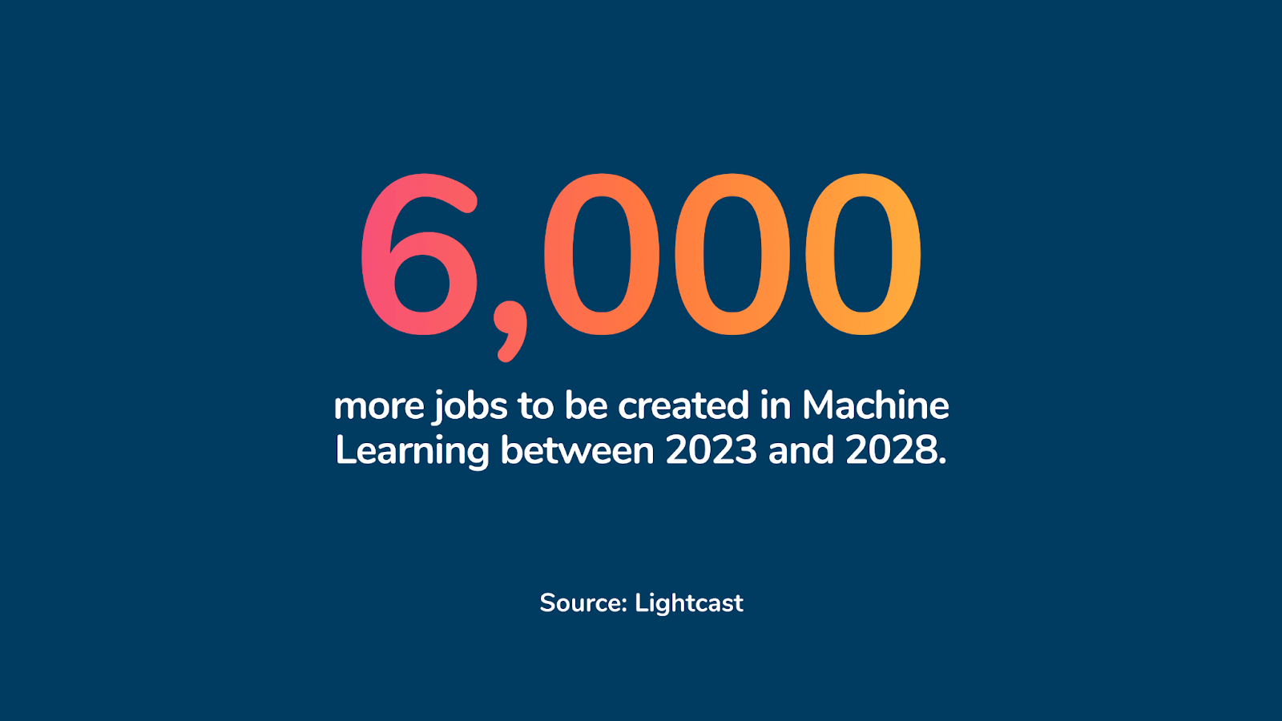

Slide 10
So what does a career in machine learning look like?
https://www.youtube.com/watch?v=cfSDvPlFFVQ

