Slide 1
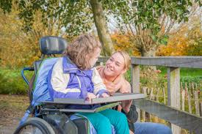
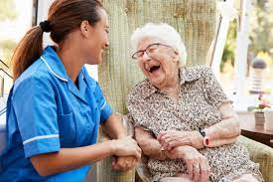
This week’s career of the week is…..
Carer/ Care Worker

Slide 2
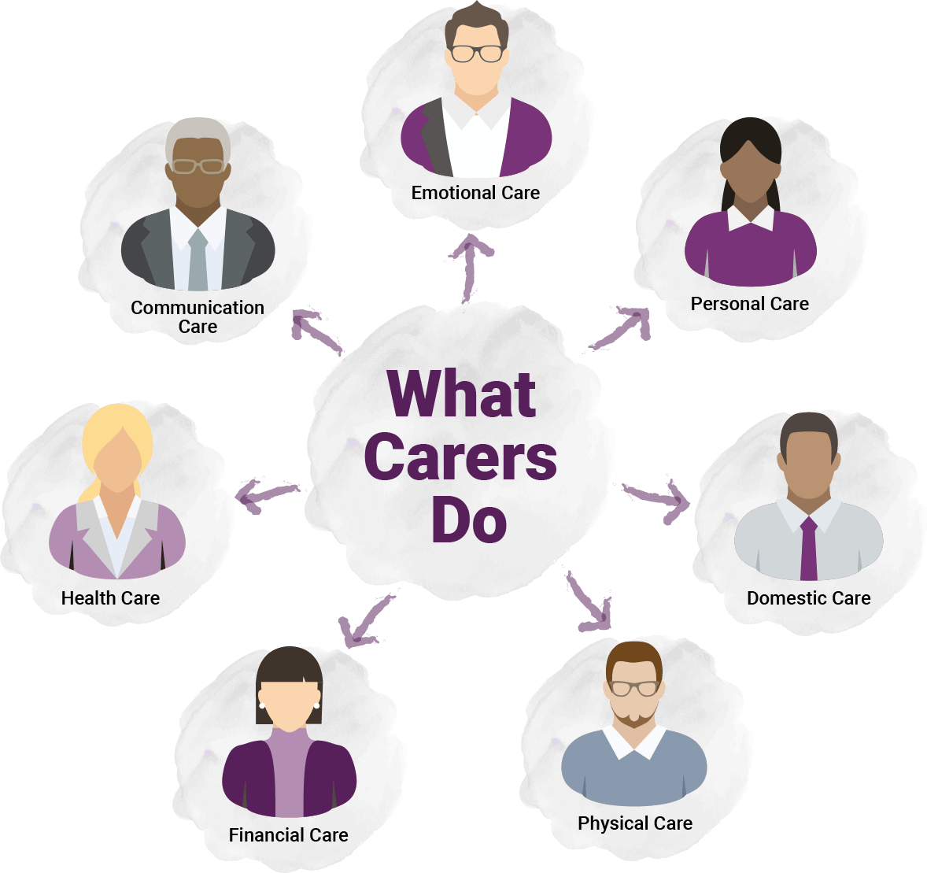
What is it??
The main role of a carer is to support people in need, from children to the elderly, who may have physical or mental difficulties.
Support is achieved through improving their lives and assisting them with their needs and day to day tasks.
Some examples of this include personal care, helping with shopping and home duties, emotional support and companionship, developing care plans with clients, families and official professionals.

Slide 3
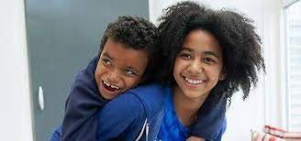
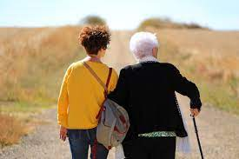
Where could I work?
Care workers can work in a care home, in people's own homes or in the community.

Slide 4
How Much Could I Earn?
Average starting salary is from £14,000.
This rises to around £25,000 for more experienced care workers.
Agency work is also very common for carers and may work out better if you are looking for flexible or part time work. Agency carer work can pay around £7-12 per hour depending on the assignment.

Slide 5
What qualifications would I need?
You can get into this job through a college course
You could take a:
Level 1 Certificate in Health and Social Care
Level 2 Diploma in Care
T Level in Health
Entry requirements
You'll usually need:
2 or fewer GCSEs at grades 3 to 1 for a level 1 course
2 or more GCSEs at grades 9 to for a level 2 course
4 or 5 GCSEs at grades 9 to 4, including English and Maths, for a T level

Slide 6
Or you could do an Apprenticeship
You could become a care worker by doing an adult care worker intermediate apprenticeship or a lead adult care worker advanced apprenticeship.
Entry requirements
There are no set entry requirements but it may help you to get in if you have:
some GCSEs, usually including English and Maths for an intermediate apprenticeship
5 GCSEs at grades 9 to 4, including English and Maths, for an advanced apprenticeship.

Slide 7
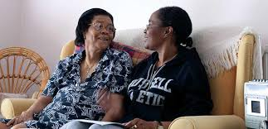
Or you could do some voluntary work
You could volunteer with an organisation that supports vulnerable people, such as a care home, charity, hospital or hospice.

Slide 8
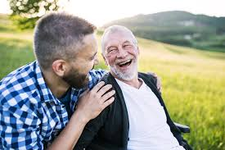
Or
You could apply directly and train on the job. You'll find it useful to have experience of working with people.
Some employers may expect you to have GCSEs in English and Maths at grades 9 to 4.

Slide 9
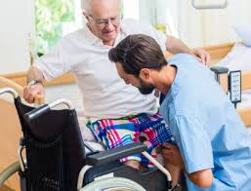
Other Skills you will Need
sensitivity and understanding
a desire to help people
the ability to work well with others
patience and the ability to remain calm in stressful situations
the ability to accept criticism and work well under pressure
to be thorough and pay attention to detail
customer service skills
excellent verbal communication skills
to be able to carry out basic tasks on a computer or hand-held device

Slide 10
Career Progression
While employed as a care worker you can develop your skills by training in specific areas, like autism awareness, communication skills or supporting people with dementia.
With experience, you can become a lead care worker. You can also move into more senior jobs, like managing people or services, if you get further qualifications.

Slide 11
So what do carers do?
Your daily tasks will depend on the needs of the person you're caring for.
For example if you're helping someone who needs support to live at home on their own, you'll:
help with washing and dressing
make food or help with eating
get to know their interests and needs
do household jobs, like washing clothes and shopping
monitor their weight and record any concerns they have
check they're taking their prescribed medications
support their physical and mental wellbeing through activities
https://www.bbc.co.uk/bitesize/articles/zkcsd6f

