Slide 1
This week’s career of the week is…..
Animator

Slide 2
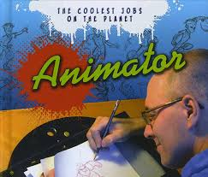
What is it??
An animator produces multiple images called frames, which when sequenced together create an illusion of movement - this is known as animation. The images can be made up of digital or hand-drawn pictures, models or puppets.
Animators tend to work in 2D, 3D model-making, stop-frame or computer-generated animation.

Slide 3
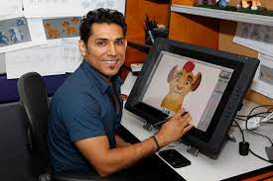
Where could I work?
Animation is an office or studio-based profession. Some experienced freelancers have studio equipment set up to work at home.
It's a global industry and many projects are for international clients. Most production companies have a list of animators they use.
The animation industry is global, but there are regional UK centres based in London, Bristol, Manchester, Dundee and Edinburgh.
Overseas and UK travel may be necessary to showcase your work at festivals or to negotiate commissions with clients.
More locally there is are animation companies in Southampton, Gloucester, Wroughton, Andover and Bournemouth.

Slide 4
How Much Could I Earn?
Entry salaries are in the region of £12,000 to £15,000. Salaries in computer game animation start higher at £18,000, rising quickly with experience.
Experienced animators can earn around £23,000 to £26,000.
Salaries for animators with at least ten years' experience are around £36,000+.

Slide 5
What qualifications would I need?
Although this area of work is open to all graduates, the following degree subjects are particularly relevant:
animation
art and design
computer-aided engineering (CAD)
electrical engineering
film and video
graphic design or illustration
model making or sculpture
multimedia
spatial design
3D design.
Entry without a higher education qualification is unusual, but not impossible. Exceptions may be made for very talented candidates. Many animators consider having an artistic background just as important as having skills in IT.

Slide 6
What skills do you need?
You'll need to show:
artistic talent and technical skills
a good eye for detail
communication and storytelling skills
ability to work with others and to take direction
networking skills and commitment to projects through previous work experience
an engagement with the industry from submitting work to festivals and competitions
the flexibility to switch between several projects at once.

Slide 7
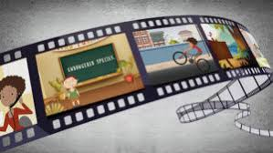
Work Experience
Animation is a competitive industry. To find work you must have a showreel. This is your portfolio to show to production companies or animation commissioners in advertising agencies, music companies or television companies. This enables them to see what you can do.
It is very useful to get work experience called a ‘residency’. Residencies provide the opportunity to work as an artist-in-residence and have access to facilities and a working environment in the creative world of work.

Slide 8
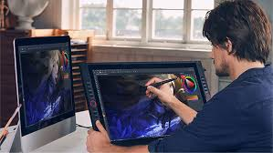
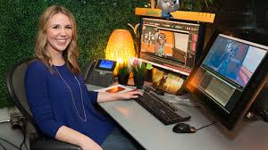
So what does an animator do?
https://www.youtube.com/watch?v=7UNPinITv1Q&t=46s

